Slide 1

P peline
The Data
Introductory Statistics: Correlation & Causality
© Jennifer Mankoff
The Data Pipeline; HCII; Spring 2014

Slide 2
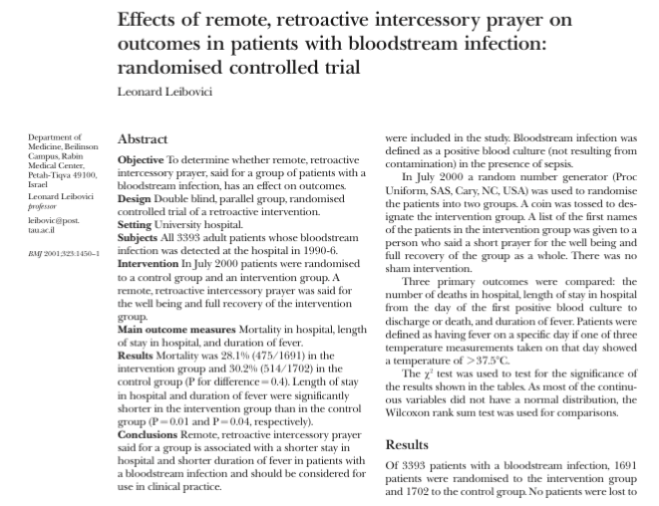
Leibovici, L. (2001). Effects of remote, retroactive intercessory prayer on outcomes in patients with bloodstream infection: Randomised controlled trial. Bmj, 323(7327), 1450-1451.
Notes:
HAND OUT ARTICLE, READ and discuss.
Can you envision a study that would convince you that a cause can lead to something happening in the past?

Slide 3
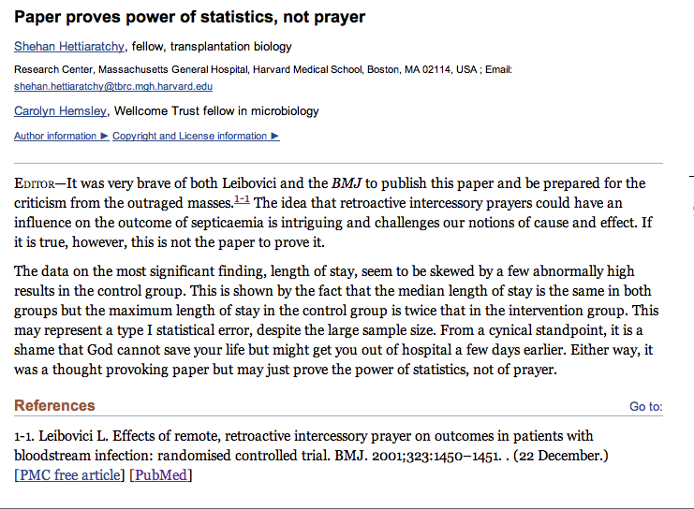
Adapted from class by Samantha Kleinberg

Slide 4
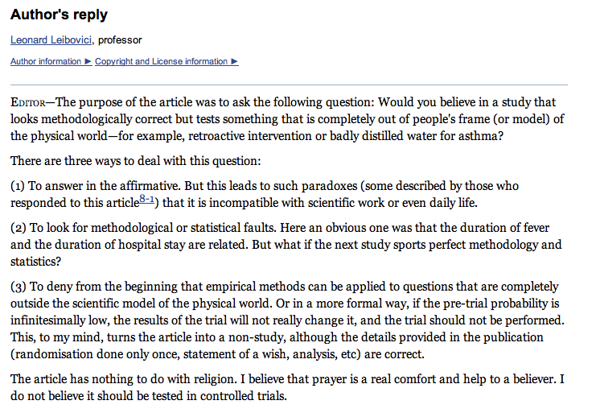
Leibovici’s reply
Adapted from class by Samantha Kleinberg
Notes:
http://www.ncbi.nlm.nih.gov/pmc/articles/PMC1122963/

Slide 5
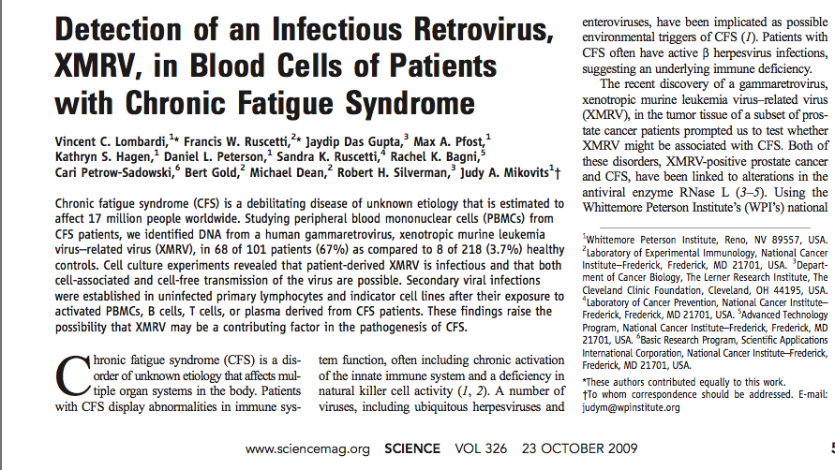
XMRV leads to CFS?
Adapted from class by Samantha Kleinberg

Slide 6
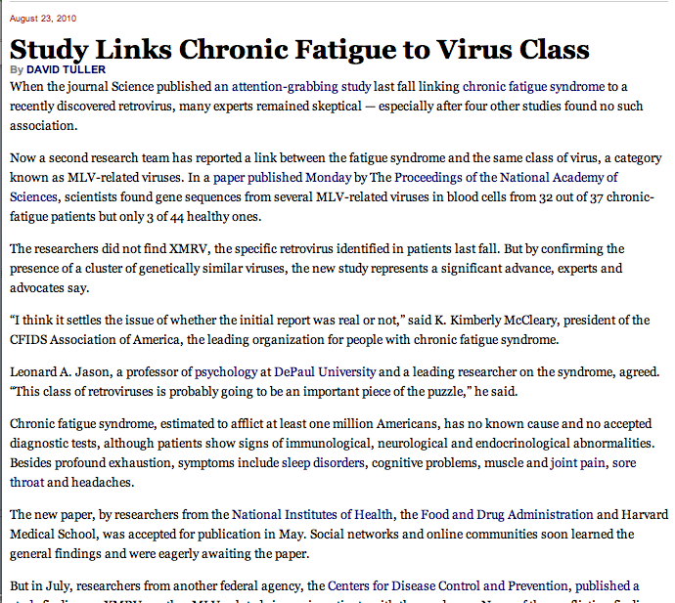
XMRV leads to CFS?
“I think it settles the issue of whether the initial report was real or not”
Adapted from class by Samantha Kleinberg

Slide 7
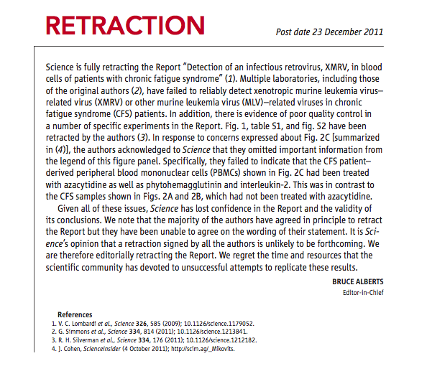
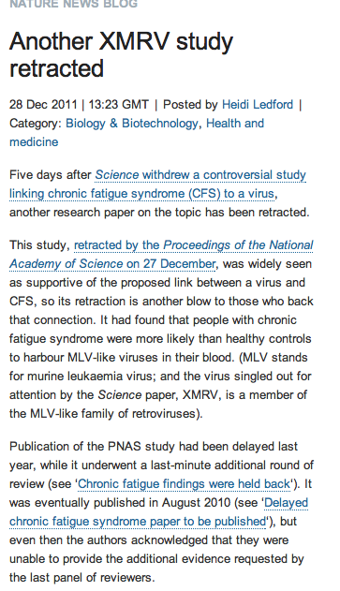
But …
Adapted from class by Samantha Kleinberg
Notes:
http://www.nature.com/news/the-scientist-who-put-the-nail-in-xmrv-s-coffin-1.11444
March 2011
Scientists at NIH present research showing that XMRV emerged from two different mouse viruses in the laboratory during the 1990s. The implication, one author told Nature, is that this virus, born in a laboratory, has probably been infecting laboratory samples for more than a decade, but not people. Meanwhile, a Nature profile of Judy Mikovits highlights growing tensions between Mikovits and her former collaborators on the initial report.

Slide 8
Goals
After this, you should be able to:
Understand how to diagram the relationships between variables
Explain the concept of causation

Slide 9
What is a Cause?
Why is it hard to prove causality
Why do we need to prove causality?
Adapted from class by Samantha Kleinberg
Notes:
Observational data/no single method for finding Prediction/explanation/intervention

Slide 10
Dependence/independence
Events that are independent
Flipping heads and then tails
Day of week and whether a patient had a heart attack (probably?)
Events that are dependent
Vice presidential candidate and presidential nominee
Diagnostic test being positive and whether patient has a disease
Adapted from class by Samantha Kleinberg

Slide 11

Regularities and experience
Past experience leads to expectation
Hear noise
Go to window
to verify
Prediction was false
Only with empirical evidence, can we make and test predictions
Adapted from class by Samantha Kleinberg

Slide 12
Correlation
Comparing Variables Systematically

Slide 13
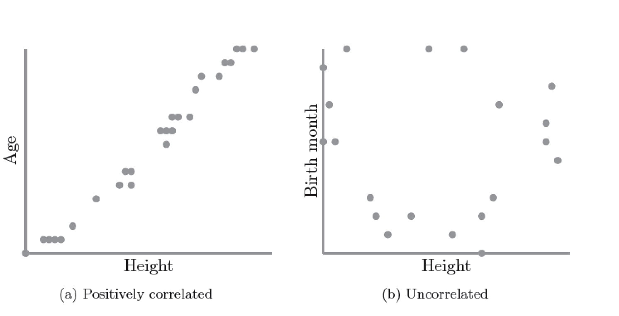
Correlation
S. Kleinberg (2015) Why: A Guide to Finding and Using Causes. O’Reilly Media.

Slide 14
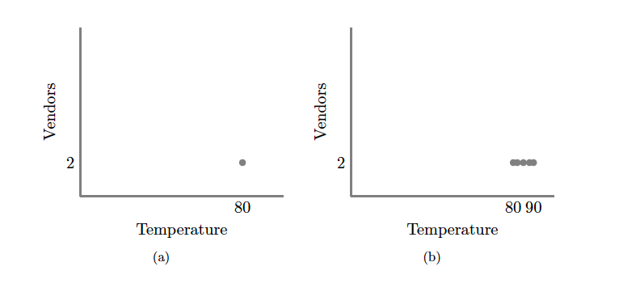
S. Kleinberg (2015) Why: A Guide to Finding and Using Causes. O’Reilly Media.
Notes:
No correlation without variation. Note: this is what happens if you ask only winners why they won

Slide 15
Scatter Plots and Correlation
A correlation analysis measures of association (relationship) between two variables
These variables change together
Usually scale (interval or ratio) variables
Analysis techniques limited to linear relationships

Slide 16
What is “Linear”?
Remember this:
Y=mX+B?
m (slope)
B (intercept)
Adapted from: http://www.sjsu.edu/people/steven.macramalla/courses/stats95/s1/lecture 10
Notes:
A slope of 2 means that every 1-unit change in X yields a 2-unit change in Y.

Slide 17
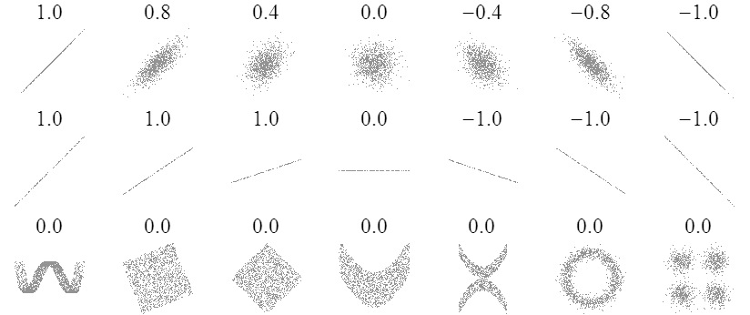
Sample Correlations
Adapted from: http://www.sjsu.edu/people/steven.macramalla/courses/stats95/s1/lecture 10
17

Slide 18
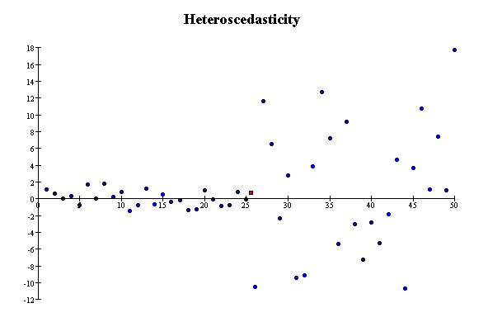
Correlation Assumptions
Key Assumptions:
X values are normally distributed within the population (for each Y)
Y values are normally distributed within the population (for each X)
X and Y have a linear relationship
There are no significant outliers
Scatter doesn’t vary over X or Y

Slide 19
Residual Analysis for Linearity
y
y
x
x
residuals
x
x
residuals
✓
Not Linear
Linear
Slide from: Statistics for Managers Using Microsoft® Excel 4th Edition, 2004 Prentice-Hall

Slide 20
Residual Analysis for Constant Variance (Homoscedasticity)
y
y
x
x
residuals
x
x
residuals
✓
Non-constant variance
Constant variance
Slide from: Statistics for Managers Using Microsoft® Excel 4th Edition, 2004 Prentice-Hall

Slide 21
Residual Analysis for Independence
✓
Not Independent
Independent
residuals
X
residuals
X
residuals
X
Slide from: Statistics for Managers Using Microsoft® Excel 4th Edition, 2004 Prentice-Hall

Slide 22
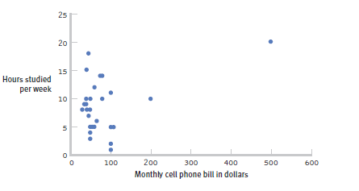
The effect of outliers
One outlier changed the correlation from -0.14 to 0.39!
Adapted from: http://www.sjsu.edu/people/steven.macramalla/courses/stats95/s1/lecture 10
Notes:
Note negative to positive change among other things
----- Meeting Notes (2/19/15 10:00) -----
cook's distance

Slide 23
Pearson Correlation Coefficient
(continued)
The population correlation coefficient ρ (rho) measures the strength of the association between the variables
The sample correlation coefficient r is an estimate of ρ and is used to measure the strength of the linear relationship in the sample observations
Adapted from http://www.fordham.edu/economics/Vinod/correl-regr.ppt

Slide 24
Features of ρ and r
Unit free
Range between -1 and 1
The closer to 0, the weaker the linear relationship
Adapted from http://www.fordham.edu/economics/Vinod/correl-regr.ppt

Slide 25
Calculating the Pearson Correlation Coefficient
Sample correlation coefficient:
or the algebraic equivalent:
where:
r = Sample correlation coefficient
n = Sample size
x = Value of the independent variable
y = Value of the dependent variable
Adapted from http://www.fordham.edu/economics/Vinod/correl-regr.ppt

Slide 26
Measuring correlation
Cups of coffee (X) vs. correct test answers (Y)
X | Y
0 | 1
1 | 1
3 | 3
4 | 5
5 | 5
Notes:
Mean of X 2.6, mean of y 3
Coffee is as related to correct answers as vice versa

Slide 27
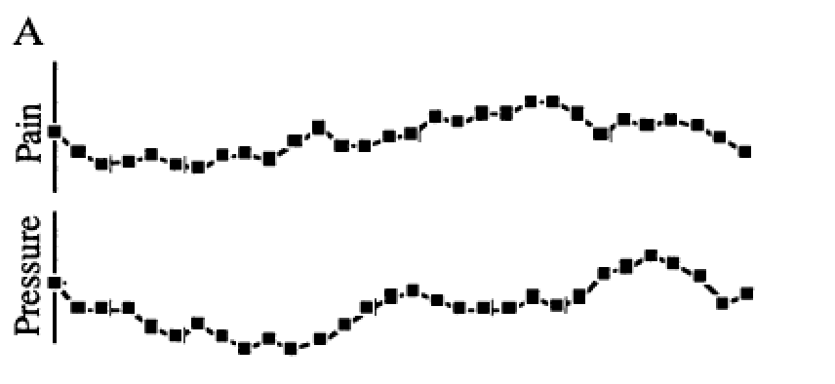
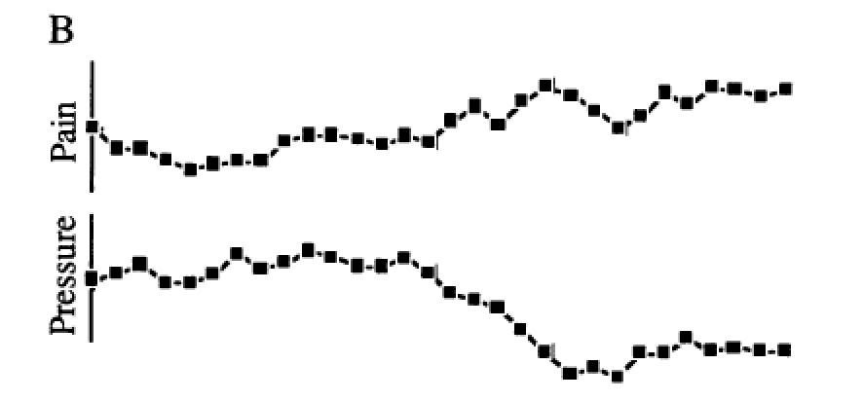
Correlation = 0!
Redelmeier DA, Tversky A (1996) On the belief that arthritis pain is related to the weather. Proceedings of the National Academy of Sciences 93(7):2895-2896.
Notes:
Cognitive bias
Fig. 1A were judged as positively related by 87%, as negatively related by 2%, and as unrelated by 11% of participants. The two uncorrelated sequences in Fig. 1B were judged as positively related by 3%, as negatively related by 79%, and as unrelated by 18% of participants.
----- Meeting Notes (8/31/15 17:30) -----
reformant

Slide 28
Correlation is not Causation
There is a 0.91 correlation between ice cream consumption and drowning deaths.
Does eating ice cream cause drowning?
Does grief cause us to eat more ice cream?
Adapted from: http://www.sjsu.edu/people/steven.macramalla/courses/stats95/s1/lecture 10

Slide 29
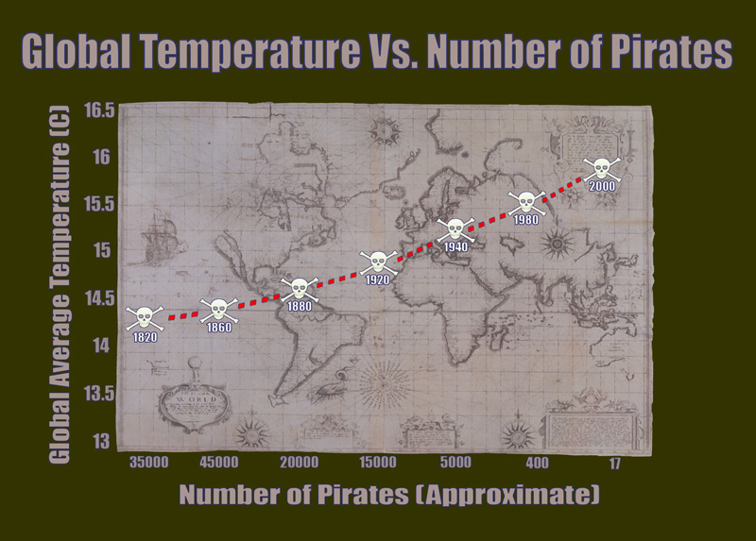
Correlation without causation (1)
http://bama.ua.edu/~sprentic
Notes:
http://bama.ua.edu/~sprentic/101%20Psych%20&%20Life--Correlation-causation.htm
But why shouldn’t we use pirates to predict temperature?
Now, why do we think pirates don’t cause global warming, or global warming doesn’t cause piracy?

Slide 30

Correlation != Causality
Adapted from http://www.fordham.edu/economics/Vinod/correl-regr.ppt

Slide 31

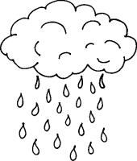
Correlation with some causation
Notes:
Directionality = why we can’t use it for prediction!
Umbrella vendors out before rain
Observe out of order

Slide 32
Correlation Summary
Measures association (linear relationship) between two variables
These variables change together
Usually scale (interval or ratio) variables
Limited in its applicability to normal, linearly related data with consistent scatter and no outliers
Often mistaken for causation
Notes:
changes in a few data-analysis decisions can increase the false-positive rate in a single study to 60%.

Slide 33
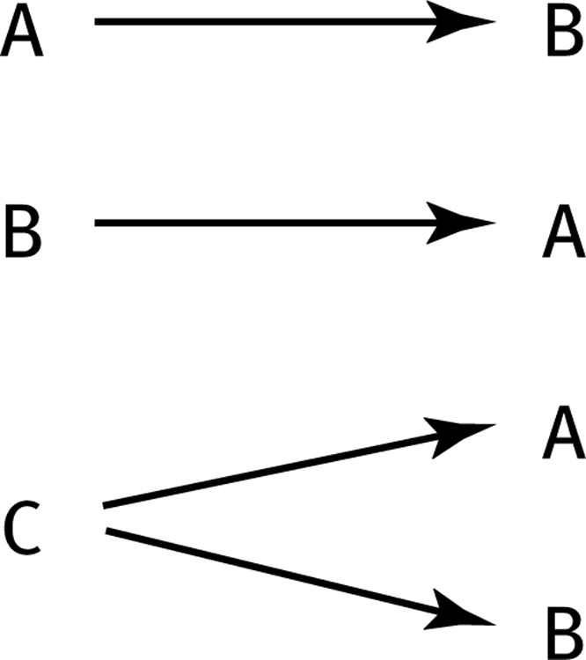
How can we test these associations?
Three Possible Causal Explanations for a Correlation
Adapted from: http://www.sjsu.edu/people/steven.macramalla/courses/stats95/s1/lecture 10

Slide 34
How can we test these associations?
Three Possible Causal Explanations for a Correlation
Adapted from: http://www.sjsu.edu/people/steven.macramalla/courses/stats95/s1/lecture 10
Notes:
Special case for C: C = Time (shared change over time)

Slide 35
Correlation Summary
Measures association (linear relationship) between two variables
These variables change together
Usually scale (interval or ratio) variables
Limited in its applicability to normal, linearly related data with consistent scatter and no outliers
Often mistaken for causation
Cannot easily determine if there is a mediating variable
Notes:
changes in a few data-analysis decisions can increase the false-positive rate in a single study to 60%.

Slide 36
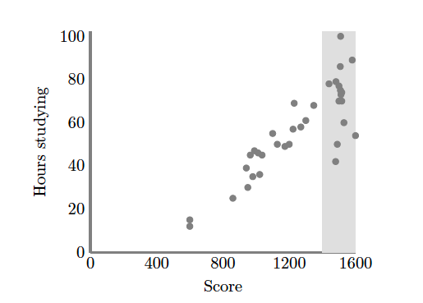
Causation without correlation
S. Kleinberg (2015) Why: A Guide to Finding and Using Causes. O’Reilly Media.
Notes:
Restricted range. Only observing grey area
Illustrate restricted range on board. When else does that happen? Surveying political website users

Slide 37
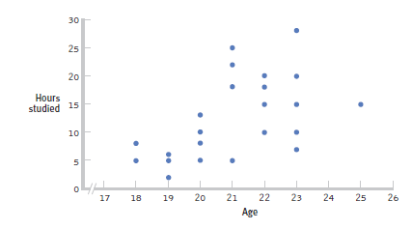
Restricted Range: Sampling Bias
Boys and girls who performed in the top 2% to 3% on standardized
Adapted from: http://www.sjsu.edu/people/steven.macramalla/courses/stats95/s1/lecture 10
Notes:
tests - a much smaller range than the full population from which the researchers could have drawn their sample.

Slide 38
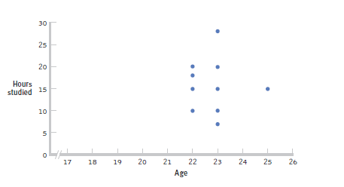
Further Restrictions
Only students between the ages of 22 and 25: r= 0.05.
Adapted from: http://www.sjsu.edu/people/steven.macramalla/courses/stats95/s1/lecture 10

Slide 39
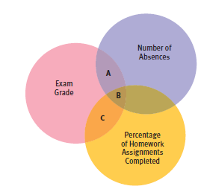
Partial Correlation
Quantifies the degree of association between two variables after statistically removing the association of a third variable with both of those two variables.
e.g., number of absences and exam grade, over and above the correlation of percentage of completed homework assignments with these variables.
Adapted from: http://www.sjsu.edu/people/steven.macramalla/courses/stats95/s1/lecture 10

Slide 40
Simpson’s Paradox
http://en.wikipedia.org/wiki/Simpson's_paradox
Introducing another variable may change our understanding of the data
It may even reverse the initial conclusions

Slide 41
A situation where the subgroups are always the way to go
 | Treatment A | Treatment B
Small Stones | Group 1 93% (81/87) | Group 2 87% (234/270)
Large Stones | Group 3 73% (192/263) | Group 4 69% (55/80)
Both | 78% (273/350) | 83% (289/350)
Notes:
Which data should we consult in choosing an action, the aggregated or the partitioned?
Kidney Stone example above, it is clear that if one is diagnosed with "Small Stones" or "Large Stones" the data for the respective subpopulation should be consulted and Treatment A would be preferred to Treatment B.
what if a patient is not diagnosed, and the size of the stone is not known; would it be appropriate to consult the aggregated data and administer Treatment B? This would stand contrary to common sense; a treatment that is preferred both under one condition and under its negation should also be preferred when the condition is unknown.

Slide 42
Gender Discrimination?
 | Applicants | Admitted
Men | 8442 | 44%
Women | 4321 | 35%
Notes:
On the other hand, if the partitioned data is to be preferred a priori, what prevents one from partitioning the data into arbitrary sub-categories (say based on eye color or post-treatment pain) artificially constructed to yield wrong choices of treatments?
Pearl[2] shows that, indeed, in many cases it is the aggregated, not the partitioned data that gives the correct choice of action.
Worse yet, given the same table, one should sometimes follow the partitioned and sometimes the aggregated data, depending on the story behind the data; with each story dictating its own choice. Pearl[2] considers this to be the real paradox behind Simpson's reversal.

Slide 43
Gender Discrimination?
Dept | Men | Women
A | 825/62% | 108/82%
B | 560/63% | 25/68%
C | 325/37% | 593/34%
D | 417/33% | 375/35%
E | 191/28% | 393/24%
F | 373/6% | 341/7%
Bickel et al.[13]: women tended to apply to competitive departments with low rates of admission (English), men tended to apply to less-competitive departments with high rates of admission engineering and chemistry)

Slide 44
Correlation Summary
Measures association (linear relationship) between two variables
These variables change together
Usually scale (interval or ratio) variables
Limited in its applicability to normal, linearly related data with consistent scatter and no outliers
Often mistaken for causation
Cannot easily determine if there is a mediating variable
Range restriction & other manipulations can affect or even reverse outcomes (Simpson’s paradox)
Notes:
changes in a few data-analysis decisions can increase the false-positive rate in a single study to 60%.

Slide 45
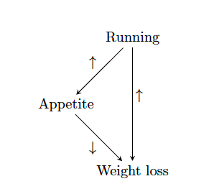
Strangely…
Causation also does not imply correlation
S. Kleinberg (2015) Why: A Guide to Finding and Using Causes. O’Reilly Media.

Slide 46
Causation without correlation
Treatment
 | Dead | Alive
A | 85 | 215 (72%)
B | 59 | 241 (80%)
Total | 144 | 456
Notes:
Treatment B is standard, A is experimental approach
Who wants treatment A and who wants treatment B?

Slide 47
Causation without correlation (2)
Treatment | Men |  | Women |  | Combined
 | Dead | Alive | Dead | Alive | Dead | Alive
A | 80 | 120 (60%) | 5 | 95 (95%) | 85 | 215 (72%)
B | 20 | 20 (50%) | 39 | 221 (85%) | 59 | 241 (80%)
Total | 100 | 140 | 44 | 316 | 144 | 456
Baker SG, Kramer BS (2001) Good for women, good for men, bad for people: Simpson's paradox and the importance of sex-specific analysis in observational studies. Journal of women's health & gender-based medicine 10: 867-872
Notes:
http://www.ncbi.nlm.nih.gov/pubmed/11747681
Ask: so what actually happened?
Levels of granularity matter!!!
Men have higher mortality rate, and more of them got treatment A than B, biasing the sample and vice versa with women.

Slide 48
How do we infer causality? How do we prove it?
Returning to Causality

Slide 49
Process vs Frequency data
Formulate
hypotheses
(Collect) & Analyze data to test hypotheses
(Bayesian inference) (Statistical inference)

Slide 50
Process vs Frequency Data
Potential for Logical Error
Potential for Systematic Error
Formulate
hypotheses
(Collect) & Analyze data to test hypotheses

Slide 51
Process vs Frequency Data
Formulate
hypotheses
(Collect) & Analyze data to test hypotheses
Potential for
Random Error;
Errors of Interpretatino
Evaluate hypotheses
Notes:
Random error (chance) can be controlled by statistical significance
or by confidence interval

Slide 52
Inference
Blends background knowledge & data
Estimates actual ratio in the population at large of things being tested for
Bayesian in nature
Helps provide grounding for what is expected in your data, lets you judge if there is sample bias, etc.

Slide 53
Theory vs empiricism
Theoretical definition
Empirical definition
Contiguity
Temporal priority
Necessary connection
Contiguity
Temporal priority
Constant conjunction
Adapted from class by Samantha Kleinberg
Notes:
Contiguity: cause and effect are nearby
Temporal priority: cause occurs prior to effect
Constant conjunction: cause regularly followed by effect

Slide 54
INUS condition
A cause is an insufficient (I) but non-redundant (N) part of an unnecessary (U) but sufficient condition (S)
Adapted from class by Samantha Kleinberg

Slide 55
INUS example
Lit match (C) may cause house fire (E)
Many cases where lit match does not cause fire
Many cases of fire without lit match (Y)
For lit match to cause fire, need oxygen, flammable materials, etc. (X)
C
E
y
Adapted from class by Samantha Kleinberg

Slide 56
INUS conditions summary
X are conditions needed for C to cause the effect
Y is a set of sufficient conditions for E
C is INUS condition of E iff:
For some X and some Y (CX or Y) is necessary and sufficient condition of E
C is not a sufficient condition of E
X is not a sufficient condition of E
There are sets of conditions that result in effect, cause is necessary part of one of those sets.
Adapted from class by Samantha Kleinberg

Slide 57
Problems for INUS
Insufficient to rule out spurious relationships
Common cause of two effects
Chance regularities
Strength of contribution
Relative nature
Adapted from class by Samantha Kleinberg

Slide 58
Murder mystery
June 27, 2005: A sleepwalker, Benjamini Adoyo goes to sleep disorder clinic. Had been wandering through house, and sometimes shaking his wife while standing over her and babbling. He had no memory of these episodes.
August 10, 2005: After sleep study, center says he has non-REM parasomnia.
October 17, 2005: Visits clinic again. Medication increased.
October 19, 2005: Adoyo is arrested and charged with killing his wife
In general, parasomniacs can kill people with no intention, awareness or memory of committing the crime
Is it murder or a result of his sleep disorder?
The Case of the Sleeping Slayer. Scientific American, September 2012, p 34-39.

Slide 59
Sleepwalker or murderer?
911 call, 3:41 am October 19, 2005
Confessed, but was confused and asked about wife’s welfare
Core question: parasomnia was known prior to incident, but was it the cause of wife’s murder?
Operator: What’s going on?
Adoyo: You just get here
Operator: You need to tell me what’s going on.
Adoyo: Somebody is dead
Operator: Somebody is dead?
Adoyo: Yes.
Operator: Where are they at?
Adoyo: In their house. Somebody is dead. Get here.
Adapted from class by Samantha Kleinberg

Slide 60
The verdict
Wasn’t nearby wife (proximity is important)
Usually no motive, but had been arguing with wife
Assaulted wife in bedroom with hammer, chased into hall & bathroom, stabbed and strangled her
Unusual to see so many mechanisms at once
Adoyo pled guilty to second degree murder
Adapted from class by Samantha Kleinberg

Slide 61
Another Example (take this home)
Sally Clark’s 1st son died in 1996, as a result of SIDS
Her 2nd son died in 1999, also as a result of SIDS
Prosecutors argued too unlikely to both be SIDS, must be murder.
Chance of SIDS = 1/8,543 so chance of 2 deaths = 1/(8,543*8,543) (approx 1 in 73 million)
What’s wrong with this?
Adapted from class by Samantha Kleinberg
Notes:
Meadow took a report estimating the chance
of SIDS as 1 in 8,543 and then said two would be one in 8,543*8,543 – approximately
73 million.1
Have you ever said it’s too unlikely to be true? Something unlikely has already happened!

Slide 62
Discussion from last class
Sally Clark’s 1st son died in 1996, as a result of SIDS
Her 2nd son died in 1999, also as a result of SIDS
Prosecutors argued too unlikely to both be SIDS, must be murder.
Chance of SIDS = 1/8,543 so chance of 2 deaths = 1/(8,543*8,543) (approx 1 in 73 million)
What’s wrong with this?
Adapted from class by Samantha Kleinberg
Notes:
Issue #1: may be an underlying comon cause
Issue #2: probability of an event != probability of guilt or innocence. Why not? Any low probability event will eventually occur (e.g. someone winning the lottery).
Need to compare probability of two SIDS against probability of two murders
Clark spent 3 years in prison.

Slide 63
Probabilities from data
How to determine probability of heads/tails from coin flip?
Frequency of event x
#(x) = number of times it is observed
Relative frequency
#(x)/N, where N is number of observations
As N→∞, relative frequency →P(x)
Adapted from class by Samantha Kleinberg

Slide 64
Conjunction
For independent events
P(A∧B)=P(A)P(B)
A∧B
A
B
Adapted from class by Samantha Kleinberg

Slide 65
Conditional probability
P(A∧B)=P(A|B)P(B), where P(B)>0
Note, if A and B independent, P(A∧B)=P(A)P(B)
Then:
Adapted from class by Samantha Kleinberg

Slide 66
Example of Bayes rule
Probability of disease (d) is 0.001
But diagnostic test not foolproof
P(+|d) = 0.98
P(+|¬d) = 0.1
Given a positive test, what’s probability patient has disease?
Adapted from class by Samantha Kleinberg

Slide 67
Example continued
Adapted from class by Samantha Kleinberg

Slide 68
Probabilistic causality: basic idea
C causes E if
P(E|C)>P(E)
Or P(E|C)>P(E|¬C)
Adapted from class by Samantha Kleinberg

Slide 69
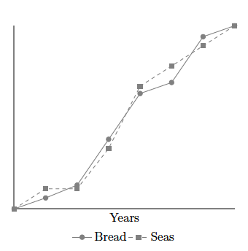
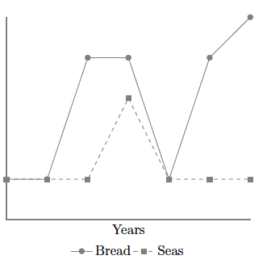
Problem: Nonstationarity
Sober, E. (2001). Venetian sea levels, British bread prices, and the principle of the common cause. The British Journal for the Philosophy of Science, 52(2), 331

Slide 70
Problem: Indeterminism
If lamp on, tv also on, so P(L|T)=1
Does switch screen off L and T?
0.9
lamp
switch
0.9
tv
Adapted from class by Samantha Kleinberg

Slide 71
Problem: Overdetermination
Bob and Susie throwing rocks at glass bottle
Rocks hit simultaneously, but Susie threw first
Susie Aims
Susie Throws
Bob Aims
Bob Throws
Glass Breaks
Time

Slide 72
Problem: Preemption
Bob’s rock arrives first and breaks glass
But Susie still threw first and has perfect aim (breaks glass with P=1)
Susie Aims
Susie Throws
Bob Aims
Bob Throws
Glass Breaks
Time

Slide 73
Seatbelt should prevent death, but causes it

Slide 74
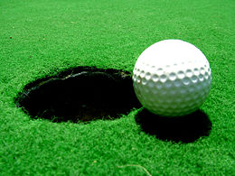
Probability trajectory
Y
P(Y) changes at x
After x P(Y) is high
P is higher than before x
P remains high until y
Was Because Of!
x
Notes:
Eg Seatbelt should prevent death, but causes it
Image from: http://www.springerlink.com/content/vm062877643u8209/fulltext.pdf
http://carsguide.110mb.com/?l=Golf_ball
“A novice golfer swings at a golf ball and the ball begins rolling toward the cup. But a
squirrel comes along and kicks the ball away. Kicks of exactly this kind have a tendency to
prevent balls from making a birdie (reducing the probability of a birdie, say, from 0.5
to 0.1). Improbably enough (since there is only 10% of chance to make a birdie) and
luckily for the golfer, in this particular case, the ball comes off the squirrel’s foot on a
new trajectory (increasing the probability of a birdie to 0.7) to roll into the cup for a birdie
at a later time.”

Slide 75
The probability of death (D) within 30 minutes of poisoning (O) is 0.8
But if an antidote (A) is given within 10 minutes of poisoning, the probability of death is reduced to 0.001
However the antidote has occasional side effects, so the probability of death when an antidote is given in the absence of the poison is still 0.001
Is O a cause of death? Is A?

Slide 76
Poison and antidote
P(D|O)=0.8 in 30 minutes
P(D|A^O)=0.001 if within 10 minutes of O
P(D|A^¬O)=0.001
Are A and O positive, negative, neutral or mixed? Better handled by Suppes or Eells?
Can impact on a specific instance be different than that at type level? When?

Slide 77

Poison and antidote
X X
1
0.8
P(death)
0.001
antidote
t
Notes:
http://en.wikipedia.org/wiki/Poison

Slide 78
Why are background contexts needed?
What if poison and antidote are administered at same time?
What about exposure that provides resistance to later bacteria?

Slide 79
Counterexample (sort of)
C likely to survive until t2 but not a later time
P(death|A)=P(death|disease)
P(death|cure)=0
BUT residual chance of death from A
C
A
B
Patient
Ineffective drug
Cure
t
t1
t2
time

